Slide 1
FTP - FILE TRANSFER PROTOCOL

Slide 2
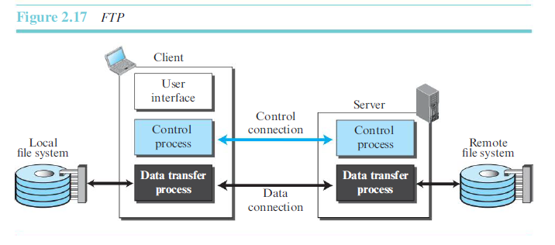
Copying a file from one host to another.
Different naming conventions, directory structures, ways of representing data etc.
FTP – used to transfer large files and files using different formats

Slide 3
Lifetimes of Two Connections
The two connections in FTP have different lifetimes.
The control connection remains connected during the entire interactive FTP session.
The data connection is opened and then closed for each file transfer activity.
It opens each time commands that involve transferring files are used, and it closes when the file is transferred. In other words,
FTP uses two well-known TCP ports: port 21 is used for the control
connection, and port 20 is used for the data connection.

Slide 4
Control Connection
For control communication, FTP uses the same approach as TELNET.
Uses the NVT ASCII character set as used by TELNET.
Communication is achieved through commands and responses.
This simple method is adequate for the control connection because we send one command (or response) at a time.
Each line is terminated with a two-character (carriage return and line feed) end-of-line token.
During this control connection, commands are sent from the client to the server and responses are sent from the server to the client.
Commands, which are sent from the FTP client control process, are in the form of ASCII uppercase, which may or may not be followed by an argument

Slide 5
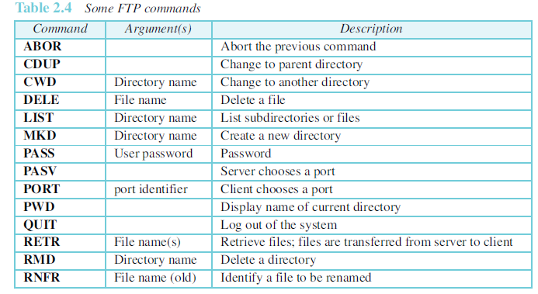
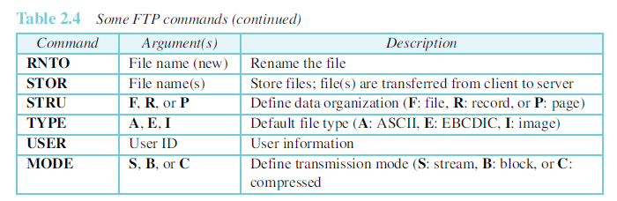

Slide 6
Every FTP command generates at least one response.
A response has two parts:
A three-digit number followed by text.
The numeric part defines the code.
The text part defines needed parameters or further explanations.
The first digit defines the status of the command.
The second digit defines the area in which the status applies.
The third digit provides additional information.

Slide 7
Data Connection
The data connection uses the well-known port 20 at the server site.
The following shows the steps:
The client, not the server, issues a passive open using an ephemeral port
The client sends this port number to the server using the PORT command.
The server receives the port number and issues an active open using the wellknown port 20 and the received ephemeral port number.

Slide 8
SSH – SECURE SHELL

Slide 9
Secure Shell (SSH) is a secure application program that can be used today, for several purposes such as remote logging and file transfer.
It was originally designed to replace TELNET. There are two versions of SSH: SSH-1 and SSH-2.

Slide 10
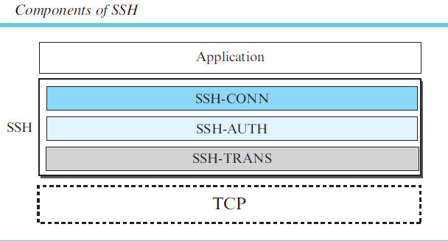
Components: SSH is an application-layer protocol with three components

Slide 11
SSH Transport-Layer Protocol (SSH-TRANS)
TCP is not a secured transport-layer protocol, SSH first uses a protocol that creates a secured channel on top of the TCP.
This new layer is an independent protocol referred to as SSH-TRANS.
When the procedure implementing this protocol is called, the client and server first use the TCP protocol to establish an insecure connection.
Then they exchange several security parameters to establish a secure channel on top of the TCP.

Slide 12
Services provided by this protocol
Privacy or confidentiality of the message exchanged
Data integrity, which means that it is guaranteed that the messages exchanged between the client and server are not changed by an intruder
Server authentication, which means that the client is now sure that the server is the one that it claims to be
Compression of the messages, which improves the efficiency of the system and makes attack more difficult

Slide 13
SSH Authentication Protocol (SSH-AUTH)
After a secure channel is established between the client and the server and the server is authenticated for the client, SSH can call another procedure that can authenticate the client for the server.
Authentication starts with the client, which sends a request message to the server.
The request includes the user name, server name, the method of authentication, and the required data.
The server responds with either a success message, which confirms that the client is authenticated, or a failed message, which means that the process needs to be repeated with a new request message.

Slide 14
SSH Connection Protocol (SSH-CONN)
After the secured channel is established and both server and client are authenticated for each other, SSH can call a piece of software that implements the third protocol, SSHCONN.
One of the services provided by the SSH-CONN protocol is multiplexing.
SSH-CONN takes the secure channel established by the two previous protocols and lets the client create multiple logical channels over it. Each channel can be used for a different purpose, such as remote logging, file transfer, etc.

Slide 15
Applications of SSH
Remote Login: PuTTY
File Transfer: sftp, scp

Slide 16
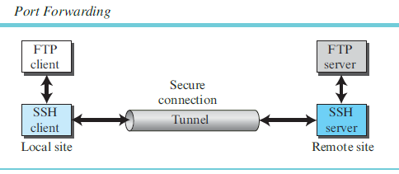
Port Forwarding
The SSH port forwarding mechanism creates a tunnel through which the messages belonging to other protocols can travel.
This mechanism is sometimes referred to as SSH tunnelling.

Slide 17
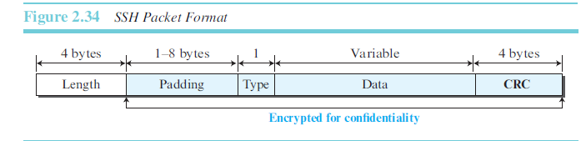
Format of the SSH Packets

Slide 18
Domain Name System - DNS
TCP/IP protocols use the IP address, which uniquely identifies the connection of a host to the Internet.
People prefer to use names instead of numeric addresses.
Therefore, the Internet needs to have a directory system that can map a name to an address.
A central directory system cannot hold all the mapping.
If the central computer fails, the whole communication network will collapse.
A better solution is to distribute the information among many computers in the world.
In this method, the host that needs mapping can contact the closest computer holding the needed information.
This method is DNS.

Slide 19
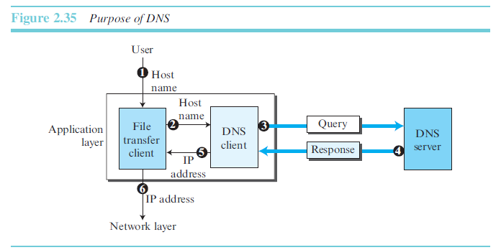
A user wants to use a file transfer client to access the corresponding file transfer server running on a remote host.
The user passes the host name to the file transfer client.
The file transfer client passes the host name to the DNS client.
Each computer, after being booted, knows the address of one DNS server. The DNS client sends a message to a DNS server with a query that gives the file transfer server name using the known IP address of the DNS server.
The DNS server responds with the IP address of the desired file transfer server.
The DNS client passes the IP address to the file transfer server.
The file transfer client now uses the received IP address to access the file transfer server.

Slide 20
Name Space
Names must be unique as IP addresses are unique.
A name space that maps each address to a unique name can be organized in two ways: flat or hierarchical.
Flat name space:
a name is assigned to an address. A name in this space is a sequence of characters without structure.
The main disadvantage of a flat name space is that it cannot be used in a large system such as the Internet because it must be centrally controlled to avoid ambiguity and duplication.

Slide 21
In a hierarchical name space, each name is made of several parts.
The first part can define the nature of the organization, the second part can define the name of an organization, the third part can define departments in the organization, and so on.
In this case, the authority to assign and control the name spaces can be decentralized.
A central authority can assign the part of the name that defines the nature of the organization and the name of the organization.
The responsibility for the rest of the name can be given to the organization itself. The organization can add suffixes (or prefixes) to the name to define its host or resources.
The management of the organization need not worry that the prefix chosen for a host is taken by another organization because, even if part of an address is the same, the whole address is different

Slide 22
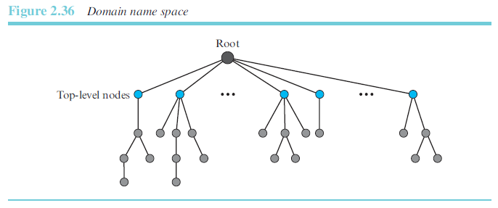
Domain Name Space
To have a hierarchical name space, a domain name space was designed.
In this design the names are defined in an inverted-tree structure with the root at the top. The tree can have only 128 levels: level 0 (root) to level 127.

Slide 23
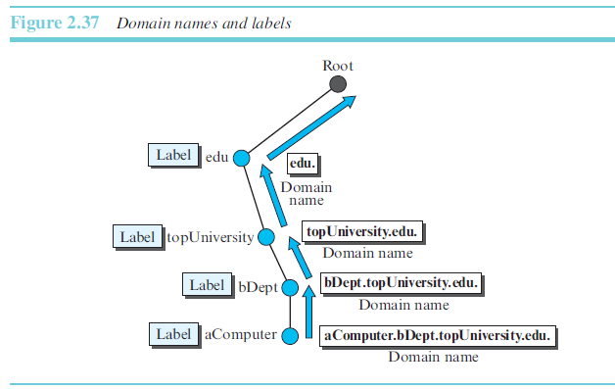
Label
Each node in the tree has a label, which is a string with a maximum of 63 characters.
The root label is a null string (empty string). DNS requires that children of a node (nodes that branch from the same node) have different labels, which guarantees the uniqueness of the domain names.
Domain Name
Each node in the tree has a domain name. A full domain name is a sequence of labels separated by dots (.).
The domain names are always read from the node up to the root. The last label is the label of the root (null).
This means that a full domain name always ends in a null label, which means the last character is a dot because the null string is nothing.

Slide 24
If a label is terminated by a null string, it is called a fully qualified domain name (FQDN).
The name must end with a null label, but because null means nothing, the label ends with a dot.
If a label is not terminated by a null string, it is called a partially qualified domain name (PQDN).
A PQDN starts from a node, but it does not reach the root.
It is used when the name to be resolved belongs to the same site as the client.
Here the resolver can supply the missing part, called the suffix, to create an FQDN.

Slide 25
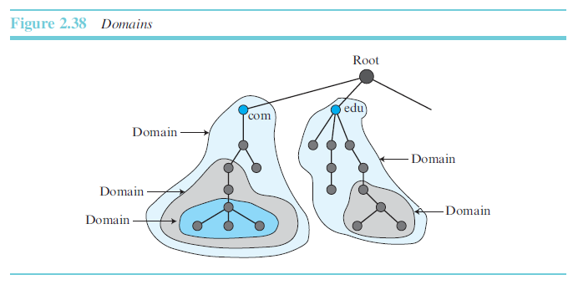
Domain
A domain is a subtree of the domain name space.
The name of the domain is the name of the node at the top of the subtree.
Distribution of Name Space
The information contained in the domain name space must be stored.
It is very inefficient and also not reliable to have just one computer store such a huge amount of information.
It is inefficient because responding to requests from all over the world places a heavy load on the system.
It is not reliable because any failure makes the data inaccessible.

Slide 26
Root Server
DNS defines two types of servers: primary and secondary.
A primary server is a server that stores a file about the zone for which it is an authority.
It is responsible for creating, maintaining, and updating the zone file.
It stores the zone file on a local disk.
A secondary server is a server that transfers the complete information about a zone from another server (primary or secondary) and stores the file on its local disk.
The secondary server neither creates nor updates the zone files.
If updating is required, it must be done by the primary server, which sends the updated version to the secondary.
A primary server loads all information from the disk file; the secondary server loads all information from the primary server.

Slide 27
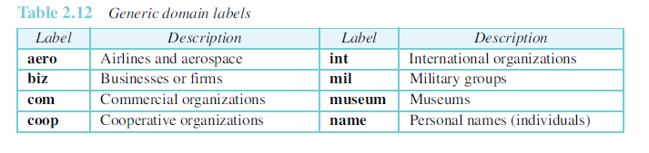
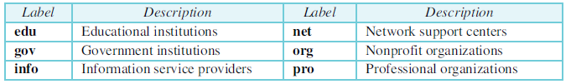

Slide 28
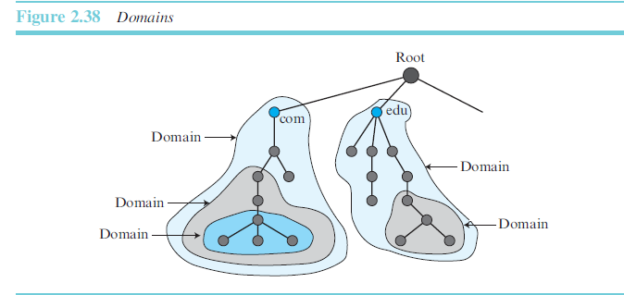
Hierarchy of Name Servers
Domain
A domain is a subtree of the domain name space. The name of the domain is the name of the node at the top of the subtree.

Slide 29
Distribution of Name Space
The information contained in the domain name space must be stored.
Very inefficient and also not reliable to have just one computer store such a huge amount of information.
Inefficient because responding to requests from all over the world places a heavy load on the system.
It is not reliable because any failure makes the data inaccessible.
Solution??? Hierarchy of Name Severs.

Slide 30
Hierarchy of Name Servers
Solution is to is to distribute the information among many computers called DNS servers.
One way to do this is to divide the whole space into many domains based on the first level.
Let the root stand alone and create as many domains (subtrees) as there are first-level nodes.
Because a domain created this way could be very large, DNS allows domains to be divided further into smaller domains (subdomains).
Each server can be responsible (authoritative) for either a large or small domain.
In other words, we have a hierarchy of servers in the same way that we have a hierarchy of names

Slide 31
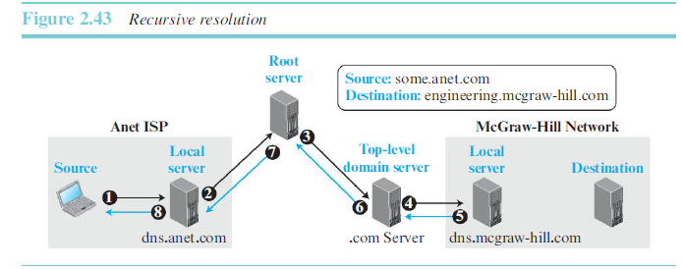
Recursive Resolution

Slide 32
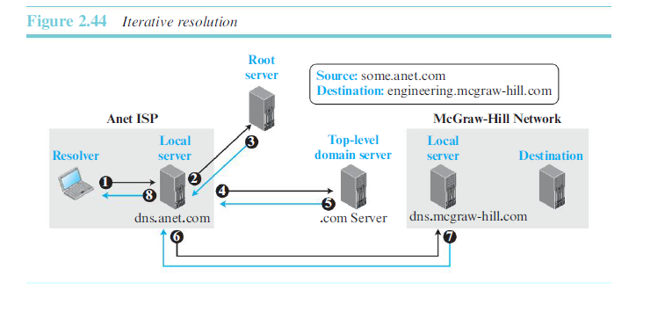
Iterative Resolution

Slide 33
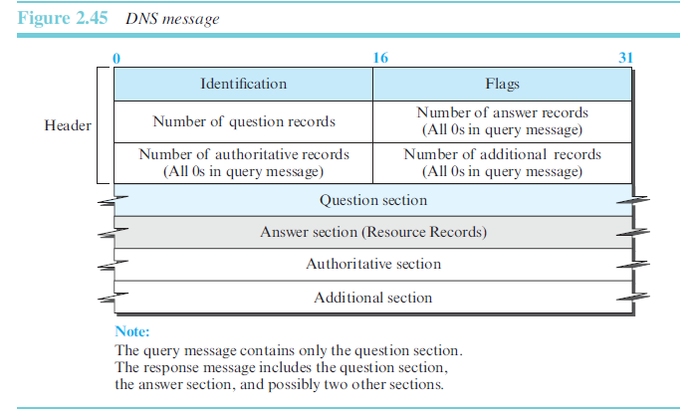
DNS Message

Slide 34
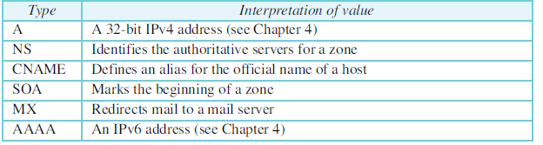
Resource Records
The zone information associated with a server is implemented as a set of resource records.
In other words, a name server stores a database of resource records.
A resource record is a 5-tuple structure, as shown below:
The domain name field is what identifies the resource record.
The value defines the information kept about the domain name.
The TTL defines the number of seconds for which the information is valid.
The class defines the type of network.
The type defines how the value should be interpreted.

